Slide 1


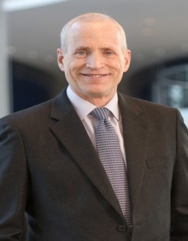
UIUC BA545_Spring 2024
Scott E. Masten
Professor of Business Economics and Public Policy
University of Michigan
James W. Meehan
Professor of Economics (Retired)
Colby College
Edward A. Snyder
Professor of Economics and Management
Yale School of Management
Masten, S.E., J.W. Meehan, and E.A. Snyder (1991). The costs of organization. Journal of Law, Economics & Organization, 7(1): 1-25.
The costs of organization
Professor Joseph T. Mahoney

Slide 2
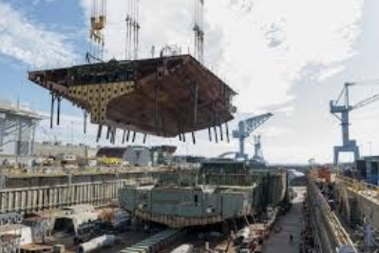

Content
01 · Based on previous limitation, propose test model
  02 · Specific Hypotheses: Naval shipbuilding
03 · Survey: 74 (43 Make; 31 Buy)
04 · Result: Probit model; Organization-Cost Estimates
05 · Conclusion

Slide 3
Main Idea
Previous studies examined factors that aggravate the hazards of market exchange (or transaction costs)
Internal organization cost as a limitation to be treated as a barrier to overcome prior to integration
Why?
  Difficult to observe and measure transaction costs
  Impossible to distinguish whether observed patterns of organization resulting from market transaction costs or from costs incurred organizing production internally
Explicitly examines the role of internal organization costs in integration decisions
Provides dollar estimates of those costs

Slide 4
(1) A tautological (Coasean) formulation
02
2. Conceptual issues
I: Institution chosen
Iº: Internal Organization
I^{m}: Market Exchange
Gº: Cost of Organization
G^{m}: Cost of Market
Limitations:
Difficult to observe and measure
Selection problem

Slide 5
(2) Reduced-form analysis
02
2. Conceptual issues
Estimate organizational form as a function of observable characteristics (e.g., asset specificity, level of uncertainty).
The resulting model is qualitative choice estimation techniques such as probit and logit (stage 1)
Hypotheses regarding organizational form can be based on the signs and relative magnitudes of the coefficients.
Limitation
Estimates provide at best only ordinal measures of those costs.
If X and Z share common elements, only the difference between β and α can be identified.

Slide 6
3) Direct tests – stronger test of the theory!
02
Only cost data for one of the institutions is required.
Could be obtained using either maximum likelihood or two-stage methods.
2. Conceptual issues
Advantages
Censored regression techniques yield dollar estimates of the costs of organization.
Can identify the magnitude of individual coefficients in the cost equations and therefore permits tests of hypotheses regarding the costs of organizing under each institutional arrangement.

Slide 7
Whether and to what extent variations in internal rather than market organization costs are responsible for observed variations in organizational form?
02
Cost of Market
Cost of Organize
2. Comparative assessment
All three variables favor organize (e.g., vertical integration)

Slide 8
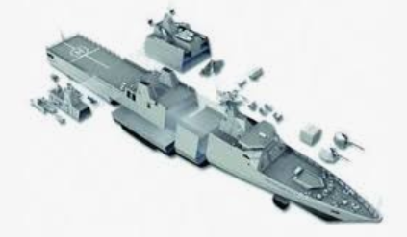
Determinants of organization costs in naval shipbuilding
03
3. Naval Shipbuilding:
favor organize
favor organize
favor market

Slide 9
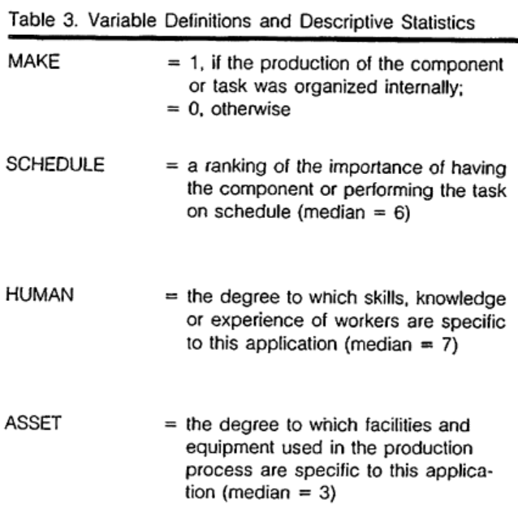
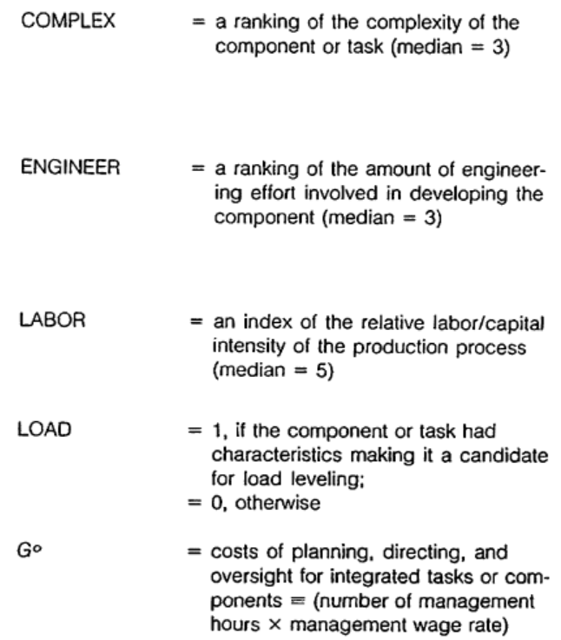
(1) Data
04
Survey : sample of tasks and components from the make-or-buy program of a large, naval shipbuilder
4. Evidence on the Structure and Costs of Organization in Shipbuilding
9

Slide 10
1st stage
2nd stage
04
Probit model
The selection decision regarding whether to organize the process internally or to subcontract the work.
Structural cost equations of the model
Estimate internal organization costs to correct for selectivity using an index constructed from the first-stage results.
Estimates of the coefficients in the (unobserved) external organization-cost equation are inferred from the parameters of the probit and internal organization cost estimates.
4. Model
Two-stage procedure

Slide 11
Y: Probability of Make
04
Corroborated
Corroborated
4. Results
Probit Estimates of Make-or-buy decisions
Non-monotonic relationship, U
Corroborated
Corroborated

Slide 12
Y: Cost of Organization
Linear
Log specifications
04
4. Results
Organization-Cost Estimates
Non-monotonic relationship, U
Corroborated
Corroborated

Slide 13
Result Summary
05
Result Summary | Hypotheses | Result
Transaction Specificities
Physical asset | (+) Organize | Falsified
Human asset | + Organize | Corroborated (only at Probability of Make)
Temporal | + Organize | Corroborated (only at Probability of Make)
Uncertainty/Complexity
Complexity | + Organize | Non-linear
Similarity of transactions
Labor intensity | - Market | Corroborated
Engineering intensity | + Organize | Corroborated
Conclusion

